Slide 1
Supporting multilingual classrooms
European Centre for Modern Languages and European Commission cooperation on Innovative Methodologies and Assessment In Language Learning
Education in linguistically and culturally diverse classrooms

Slide 2
Supporting multilingual classrooms
European Centre for Modern Languages and European Commission cooperation on Innovative Methodologies and Assessment In Language Learning
Reflecting on myths, realities and challenges to benefit
from multilingualism

Slide 3
Objectives
To share some information about your own contexts
To be informed about myths and reality regarding multi/plurilingualism
To critically reflect on the challenges and benefits of plurilingualism

Slide 4
Quizcards
In groups of 4-5, randomly select cards for brief discussion (15 minutes)

Slide 5
Maledive project
Teaching the language of schooling in the context of diversity
Profiles of learners in diverse contexts
Activities for use in the classroom and for teacher reflection

Slide 6
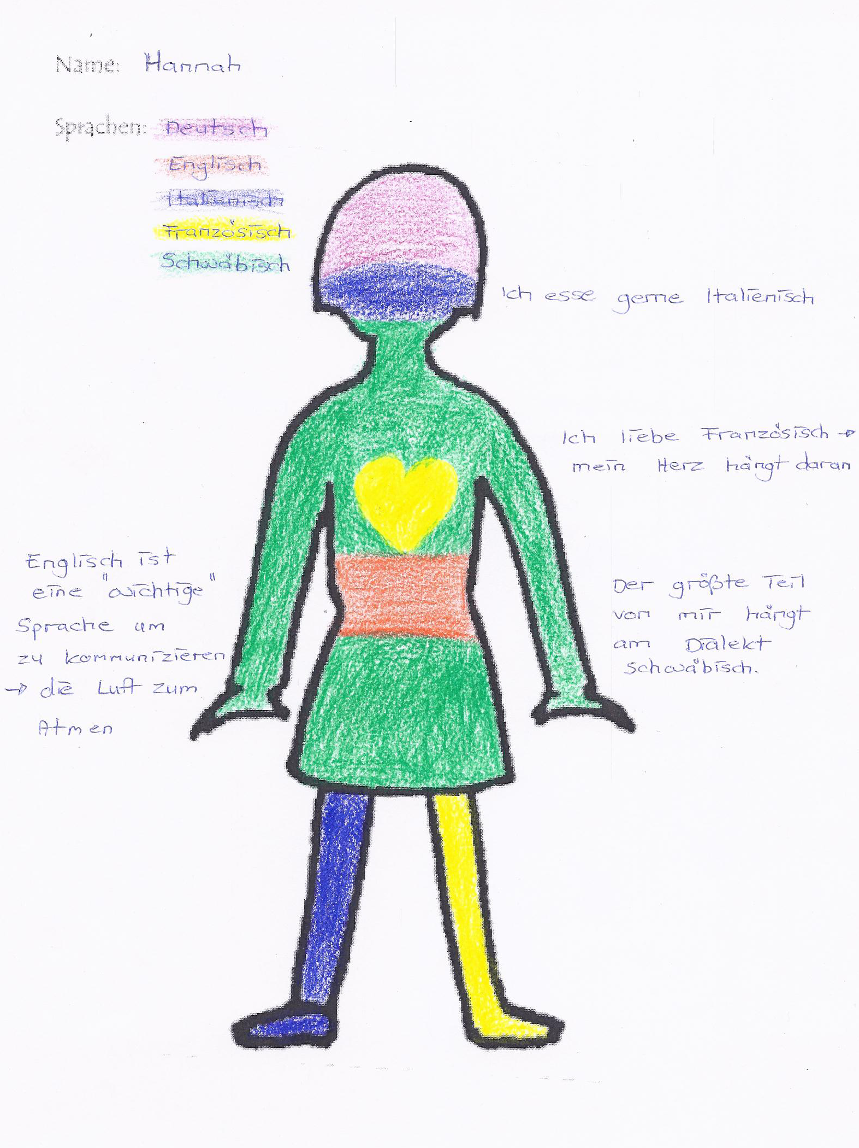

Slide 7
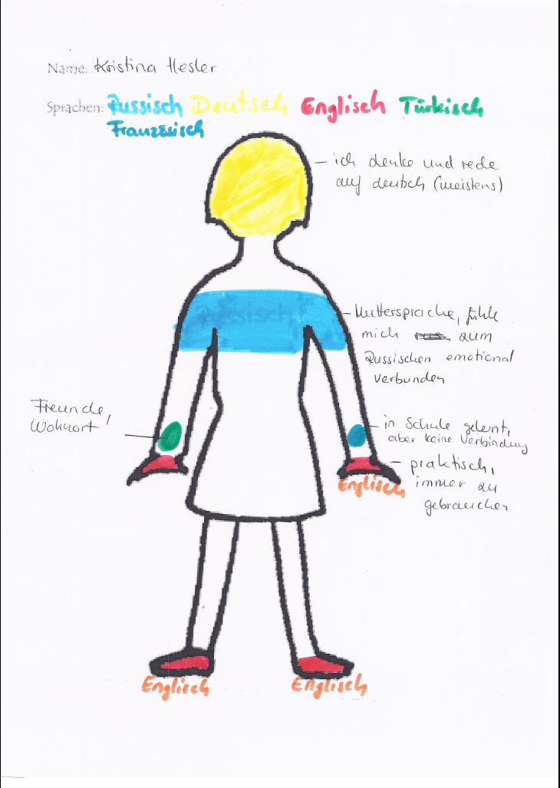

Slide 8
Learner profiles
Kevin
Neslihan
Yasmine

Slide 9
Challenges: Kevin
Kevin doesn't appreciate why it could be beneficial to learn additional languages: career advancement, openness to the world which is largely multilingual
Kevin displays a negative view of other languages and cultures whether they are dominant (Spanish, Arabic) or minority (Scots, Ingala)
Kevin doesn't make connections between his first language, English and his foreign language at school (Spanish)

Slide 10
Transforming challenges into resources: Kevin
Benefit of have many languages in their linguistic repertoire for their public and private life – jobs, family movement, travel etc
Activities to encourage them to learn about other languages, language families etc
Activities to compare languages; value of transferring knowledge from one language to another

Slide 11
Challenges: Neslihan
Neslihan only uses one language per context – never both (diglossia); why is this a problem?
Neslihan has everyday English (BICS) but struggles with academic English (CALP)
Neslihan doesn't make connections between her first language, English and her foreign language at school (Spanish)

Slide 12
Transforming challenges into resources: Neslihan
Valorising bilingualism/plurilingualism
Activities to transfer learning across languages
Finding out about common errors from Turkish to English

Slide 13
Challenges: Yasmine
Yasmine does not understand what is going on in class
Yasmine (and the teacher) does not know she has academic skills (CALP) in Arabic – these are developed in her first language
Yasmine does not transfer her abilities in other languages or use one language to help her to understand another

Slide 14
Transforming challenges into resources: Yasmine
Explicit learning of language of classroom instructions, routines etc
Learning about life in a Scottish school
Teachers need to find out how to assess her knowledge in other languages as she can’t show it in English
Valorising bilingualism/plurilingualism
Opportunities to use other languages
Activities to transfer learning across languages
Develop her English

Slide 15
Reflecting on myths about plurilingualism
Choose two of the statements and give some reasons why you think they are wrong or right.
Compare your perspective with the statements of Grosjean or Tracy here

Slide 16
Returning to the case studies
Look at the children’s narratives again
How might these be viewed differently and more positively?
Instead of them being perceived just as problems, how might the languages they are exposed to enrich their lives and learning?

Slide 17
Summary
Jot down as many reasons as you can why plurilingualism should be supported.
Keep adding throughout the workshop as other ideas occur to you – including how to support.

Slide 18
Supporting multilingual classrooms
European Centre for Modern Languages and European Commission cooperation on Innovative Methodologies and Assessment In Language Learning
Benefiting from linguistic diversity across the curriculum

Slide 19
Objectives
To develop a plurilingual dimension in different subjects
To experience ECML resourcesand consider ways of adapting them for the Czech context
To reflect on multilingualism as a resource for all

Slide 20
In pairs, and reflecting back on yesterday:
How might linguistic diversity benefit learning for all children in the classroom? What can they learn?
Write down your ideas
Share with another pair

Slide 21
Conbat+
Content-based Teaching + plurilingualism
Enriches other subjects with a plurilingual dimension
Is context-dependent
Aims at helping learners develop their multiple identities

Slide 22
Group work
You will work through one of four packs according to relevance, doing and discussing the activities:
Motion in the Ocean (ages 9-14)
Our home, Our world (ages 10-12)
Chocolate (ages 10-14)
Coffee (ages 12-15)

Slide 23
Focus questions
What are the benefits to plurilingual children?
What are the benefits to all children?
What exactly would children learn from these resources and activities?
How might they be adapted for your own context? (subject, age group etc)
Can you think of other activities in other subjects?
What obstacles might there be to you doing this kind of activity? How might you get over them in order to include at least some aspects of this kind of learning?

Slide 24
Supporting multilingual classrooms
European Centre for Modern Languages and European Commission cooperation on Innovative Methodologies and Assessment In Language Learning
Supporting children with the language of schooling across the curriculum

Slide 25
Objectives
To develop practical approaches to supporting plurilingual children to access the language of schooling across the curriculum
To share your own strategies and develop them
To explore scaffolding strategies
To develop differentiated teaching materials
To consider the role of formative assessment

Slide 26
Moises in school
Watch the start of the film about Moises
What do you learn about Moises?
What does Moises do to try to participate in the lesson?
How can the teacher help him?
What would you do to help Moises in the classroom? What happens or might happen in your school?

Slide 27
Scaffolding learning
The term “scaffolding” refers to the support that enhances learners’ ability to develop new knowledge and skills that are transferable to new contexts.
Scaffolding is by definition temporary help that assists students to become more independent and capable of handling learning more on their own. What a student can with support today, (s)he will be able to do alone tomorrow. Scaffolding makes the students aware of how to do the learning tasks and how to learn new content, so that they will be better able to complete tasks on their own.
(from Maledive)

Slide 28
Sharing ideas for scaffolding learning (15 minutes)
Group discussion
How might you adjust the basic tasks on the handout?
Look at the handout on scaffolding at macro and micro levels and share which you already do and which you might try.
Look at Maledive on Scaffolding

Slide 29
Pluriliteracies Teaching for Learning
Shows teachers and materials developers ways of fostering deep learning by paying attention to the development of students‘ subject specific literacies
Further ideas on scaffolding
Ideas about how to differentiate materials

Slide 30
Group work
In groups, look at the types of activity in one of the three Pluriliteracies packs of worksheets:
Avalanches (novice level)
Chemistry: The Process of Corrosion Materials (novice level)
Desertification (intermediate level)

Slide 31
Focused questions
List as many ways as you can find in which the sheets offer scaffolded/differentiated activities to support a range of different learners
Can you add to the list of ideas from your own practice?

Slide 32
Language Descriptors
These resources highlight challenges for young learners in subject classes where the language of instruction is not their first language.
Focus on minimum language standards in history/civics and mathematics for learners aged 12/13 and 15/16.
The language descriptors are linked to CEFR levels A2, B1 and B2.
Available in six languages (English, French, Finnish, Lithuanian, Norwegian, Portuguese).

Slide 33
Adapting the descriptors for self-assessment
Do you use self-assessment?
How might these Language Descriptors be used?
Can they also be used by the three children in our initial Learner Profiles to reflect on all of the languages in their repertoire?

