Slide 1
« Languages at the heart of learning » The European centre for modern languages of the Council of Europe (ECML)

Slide 2
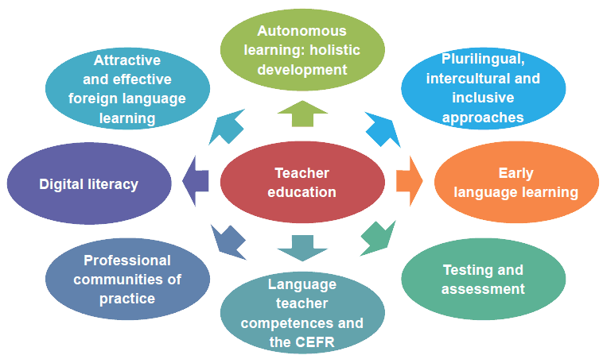
Current priorities in ECML member states

Slide 3
ECML: who we are and what we do
An enlarged Partial Agreement
of the Council of Europe with 33 member states; founded in Graz, Austria in 1994
Mission
innovation in language learning and teaching; implementation of effective language education policies
Key target audience
decision-makers, teacher-trainers, language teachers
4 year programmes
of international projects and bilateral training and consultancy
Our vision
A Europe committed to linguistic and cultural diversity, where the key role of quality language education in achieving intercultural dialogue, democratic citizenship and social cohesion is recognised and supported.

Slide 4
ECML Programme 2016-19
“Languages at the heart of learning”
Development
Projects
Think tanks
Support in national contexts
Activities for a wider public
Mediation

Slide 5
ECML training and consultancy for member states
Targeted, tailored support to address national challenges
Supporting Multilingual Classrooms*
Plurilingual education
Testing and Assessment (RELANG)*
Quality education in Romani
Quality assurance in language and citizenship courses
Language teacher education
Content and Language Integrated Learning
Use of ICT in support of language teaching and learning
Plurilingual and intercultural learning through mobility
Using the European Language Portfolio
* in cooperation with the European Commission

Slide 6
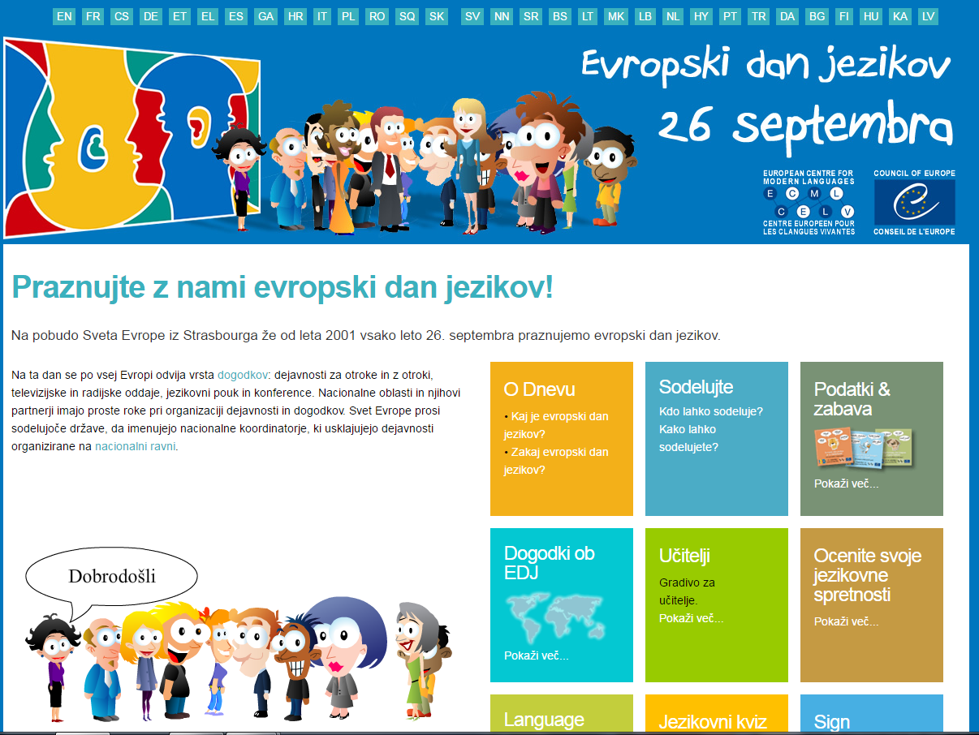

Slide 7
ECML: a unique centre for language education
ECML key services
Addressing national needs through Training and Consultancy
Building networks and partnerships within and beyond Europe
Providing practical resources for language professionals
Future-proofing through innovative projects
Encouraging language learning through the European Day of Languages

