Slide 1
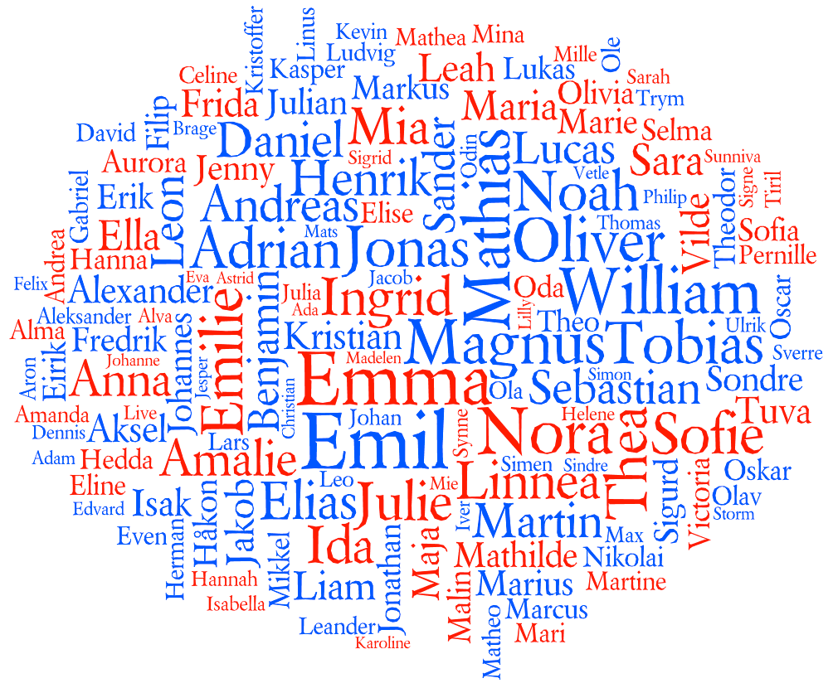
What‘s in a name?
European Centre for Modern Languages and European Commission cooperation on Innovative Methodologies and Assessment In Language Learning

Slide 2
What’s in a name?
What can I guess / know?
Boys / girls (obvious in Czech)
Possibly different country
Two first names – something new
Vietnamese / Russian / Balkanic names can be recognized
Christian name
Group can be more difficult to make into a community
Knowing family background - prejudice

Slide 3
What’s in a name?
Possible objectives
Get to know each other – kind of game – fun – interaction – interesting information about new pupils (how they would like to be addressed – proper pronounciation – cultural background)
History lesson – origins of names (not just Greek – Latin) – Language lesson: could be a nice warm-up – Be careful if there is a new comer – Use it for all children, not just for one pupil arriving
History lesson – why has the name been chosen – family memory – find out one other person with the same name who was important (they introduce this person) – Create a good and open atmosphere

Slide 4
What’s in a name?
Found this name: Jean Male (French) Translation in Czech: Johan Male Translation in Czech: Ivan Male Translation in Czech: Jan Male Found this name: Jean Female (English) Translation in Czech: Jana Female
http://www.namepedia.org/en/firstname/translate/

Slide 5
What‘s in a name?
Possible objectives
Getting to know each other
Creating a group dynamic
Having pleasure working with different languages
Exploring identity
Exploring, playing with languages
Becoming aware of similarities and differences
Becoming aware of linguistic phenomena

Slide 6
What’s in a name?
Becoming aware of one’s representations, of how quickly we imagine something about people we don’t know
Observing the linguistic and cultural diversity of contexts and individuals
Recognising the linguistic and cultural diversity of contexts and individuals
…

