Slide 1
Who are these people?
1
2
3
4
5
A
Where are they from?
How old are they?
What is their eductional background?
What language(s) do they speak?
What is theiir job?
What are their hobbies?
What about their past life?
Other details?
B
C
D
E

Slide 2
Project - LEA
« Stereotypes are not negative by themselves, they are short cuts used for quick thinking with very limited information. However, social relations cannot be affected by stereotypes, particularly in educational contexts because stereotypes reduce identity to a small number of interpretative guidelines, isolating it from a rich pluricultural perspective. Awareness, reflection and criticism must be our constant objectives in relation to stereotypes. »

Slide 3
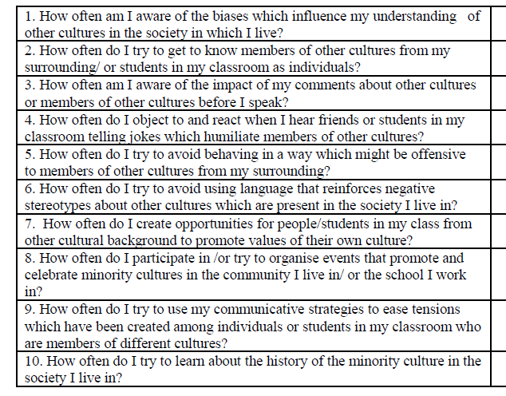
LEA – Raising Pluricultural awareness

