Slide 1
Supporting Multilingual classrooms
Prague, 27-28 April, 2017

Slide 2
ECML www.ecml.at
An enlarged Partial Agreement
of the Council of Europe with 33 member states; founded in Graz, Austria in 1994
Mission
innovation in language learning and teaching; implementation of effective language education policies
Key target audience
decision-makers, teacher-trainers, language teachers
4 year programmes
of international projects and bilateral training and consultancy
Notes:
The ECML’s work within its programme moves beyond the foreign language classroom to include all linguistic abilities and the needs of all groups of learners. The programme, which promotes inclusive, plurilingual and intercultural education is strongly based upon the principles agreed upon by the members of the members of the Professional Network Forum in formulating the Graz Declaration on language education in 2010.

Slide 3
ECML: a unique centre for language education
ECML key services
Addressing national needs through Training and Consultancy
Building networks and partnerships within and beyond Europe
Providing practical resources for language professionals
Future-proofing through innovative projects
Encouraging language learning through the European Day of Languages
Notes:
http://www.ecml.at/Aboutus/professionalnetworkforum/tabid/137/language/en-GB/Default.aspx

Slide 4
ECML Programme 2016-19
“Languages at the heart of learning”
Development
Projects
Think tanks
Support in national contexts
Activities for a wider public
Mediation

Slide 5
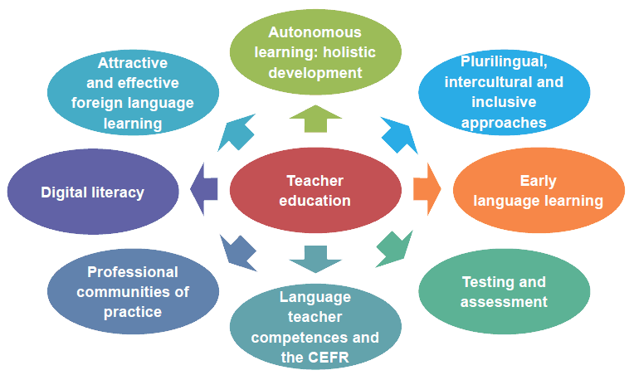
Current prioroties in ECML member states

Slide 6
Themes of the current programme
Language teacher competences
Migration and language education
Sign languages
Plurilingual education
New media in language education
Mobility and intercultural learning
Evaluation and assessment
Employment and languages
Early language learning
Content and language integrated learning
Languages of schooling
CEFR and ELP

Slide 7
ECML training and consultancy for member states
Targeted, tailored support to address national challenges
Supporting Multilingual Classrooms*
Plurilingual education
Testing and Assessment (RELANG)*
Quality education in Romani
Quality assurance in language and citizenship courses
Language teacher education
Content and Language Integrated Learning
Use of ICT in support of language teaching and learning
Plurilingual and intercultural learning through mobility
Using the European Language Portfolio
* in cooperation with the European Commission

Slide 8
O dni jazyků
Kdo a jak se může zapojit?
Informace a zábava
Akce EDJ
Učitelé
Ohodnoťte si sami své jazykové dovednosti
Zajímavosti o jednotlivých jazycích
Jazykový kvíz
Znaková řeč- hra
http://edl.ecml.at

Slide 9
Resources
All of the publications produced by the ECML can downloaded in pdf format free of charge.
The European Language Gazette
Experts Database
International Events Calendar

Slide 10
Members of the Professional Network Forum
ACTFL, the American Council on the Teaching of Foreign Languages
AILA, the International Association of Applied Linguistics
ALTE, the Association of Language Testers in Europe
CercleS, the European Confederation of Language Centres in Higher Education
EALTA, the European Association for Language Testing and Assessment
EAQUALS, the Evaluation and Accreditation of Quality in Language Services
ECSPM, the European Civil Society platform for multilingualism
EFNIL, the European Federation of National Institutions for Language
CEL/ELC, the Conseil Européen pour les Langues/ European Language Council
EPA, the European Parents' Association
EUNIC, the European Union National Institutes for Culture
FIPLV, the Fédération Internationale des Professeurs de Langues Vivantes
IAM, the International Association of Multilingualism
ICC, the International Certificate Conference
OLBI, the Official Languages and Bilingualism Institute of the University of Ottawa
ECML

