Slide 1
Sylvie Doláková
Jak učit výslovnost anglického jazyka tak, aby to žáky bavilo?

Slide 2
Why is pronunciation important for learners?
To be understood
To understand each other

Slide 3
Why is pronunciation important for the teacher?
To be understood
To be a good model for children
To guarantee the correct imitation of sounds
To facilitate good pronunciation techniques
To make pronunciation exercises enjoyable and beneficial

Slide 4
Let‘s try if we can do that…

Slide 5
hello

Slide 6
their
there
they‘re

Slide 7
car
robot
very

Slide 8
oven
owl
wet
vet

Slide 9
finger
singer
singing

Slide 10
dear
pear

Slide 11
live
leave
life

Slide 12
listened
asked
wanted

Slide 13
man - men
bag – beg
said - sad

Slide 14
hotel
fourtheenth
eighty

Slide 15
gorilla
kangaroo
giraffe
canary

Slide 16
comfortable
strawberry

Slide 17
My Bonnnie is over the ocean.
My Bonnie is over the sea.
My Bonnnie is over the ocean.
Oh bring back my Bonnie to me.
Bring back, bring back,
Oh bring back my Bonnie to me, to me.
Bring back, bring back,
Oh bring back my Bonnie to me, to me.

Slide 19
Fonetický přepis
Ano či ne?

Slide 20
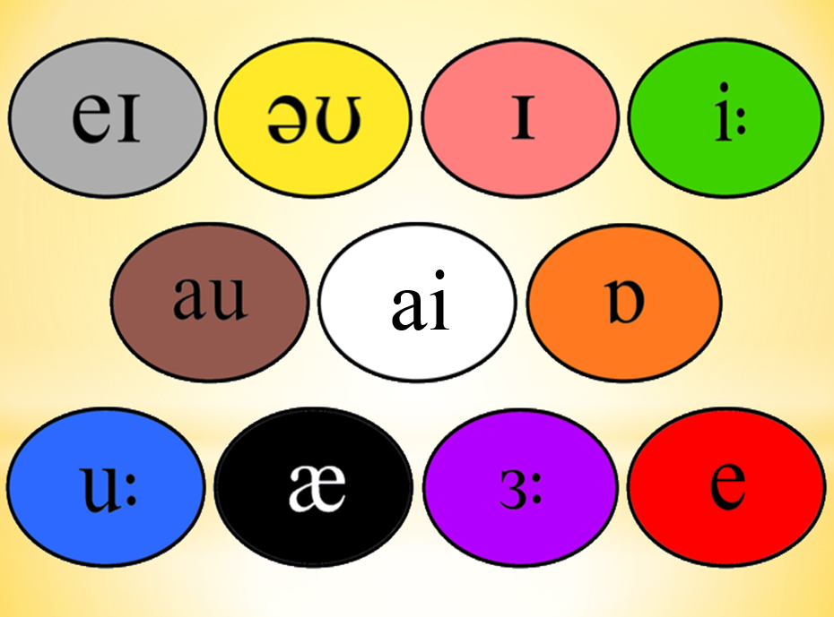

Slide 21
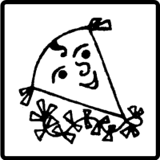

Slide 23
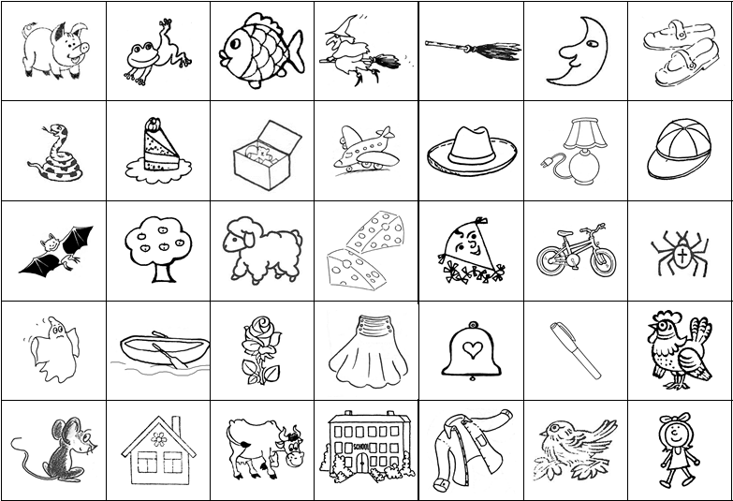

Slide 24
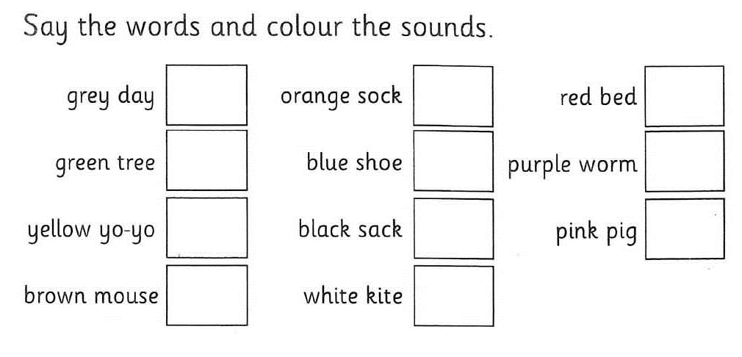

Slide 25
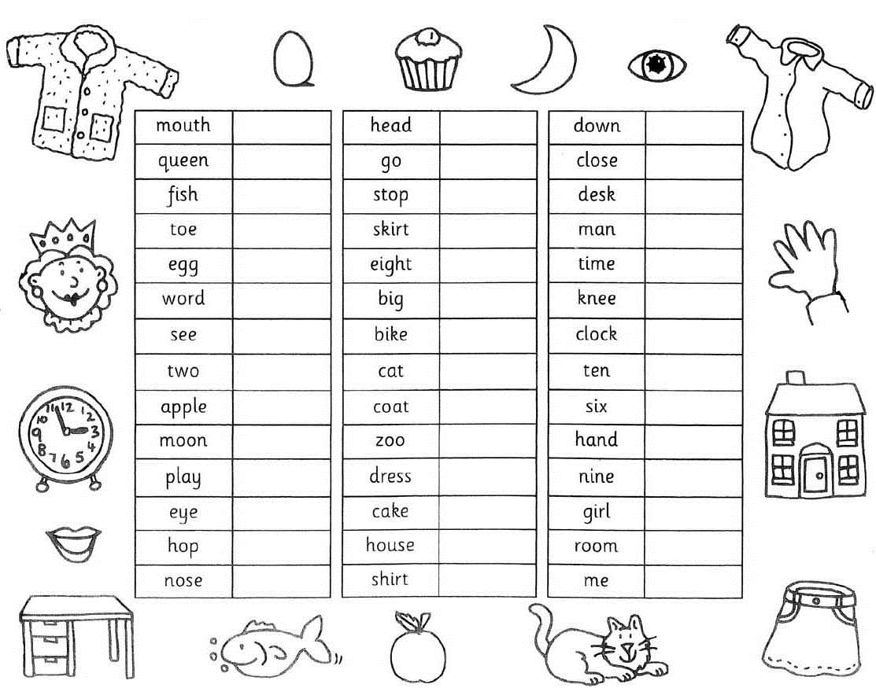

Slide 26
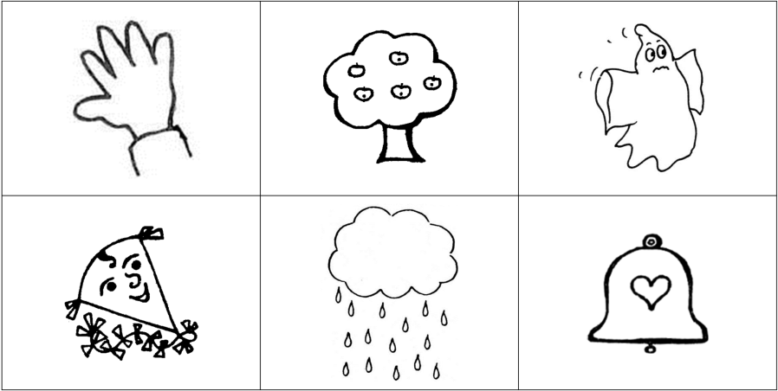

Slide 28
Fruit Chant

Slide 29
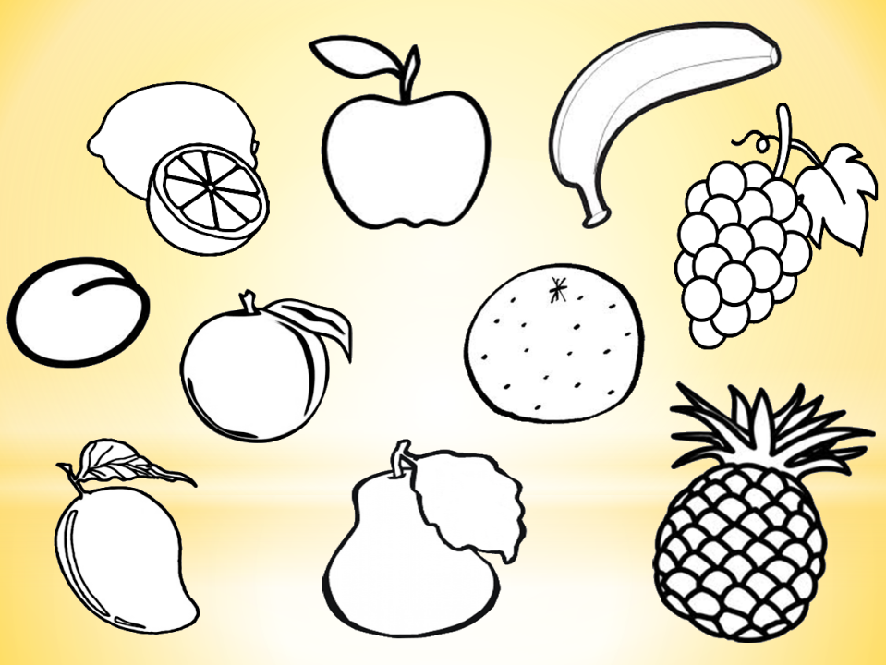

Slide 30
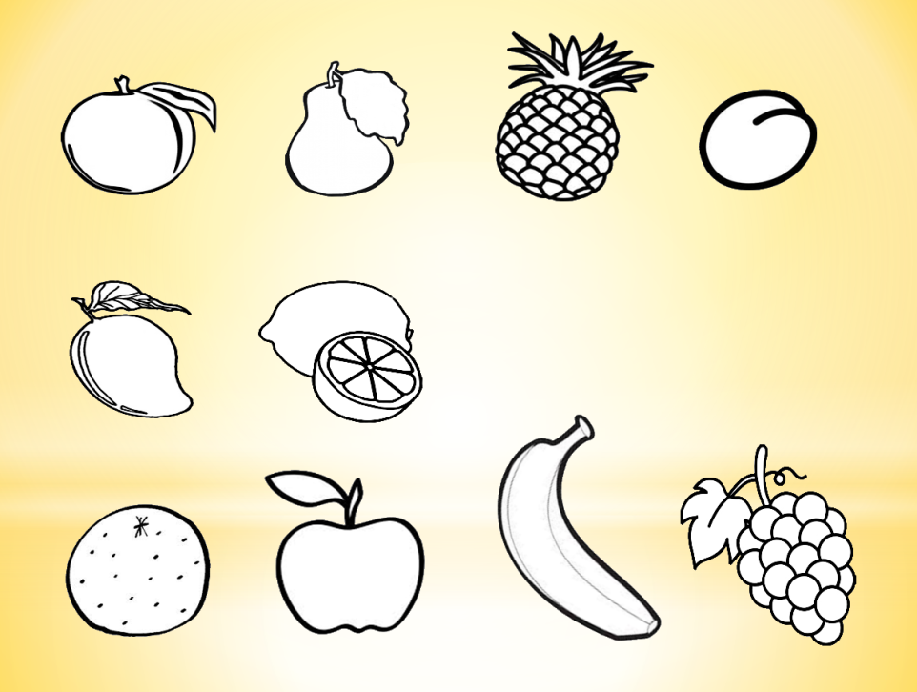

Slide 31
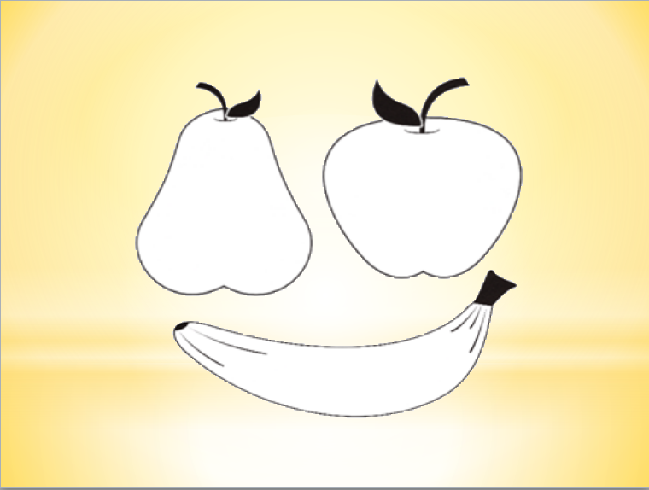

Slide 32
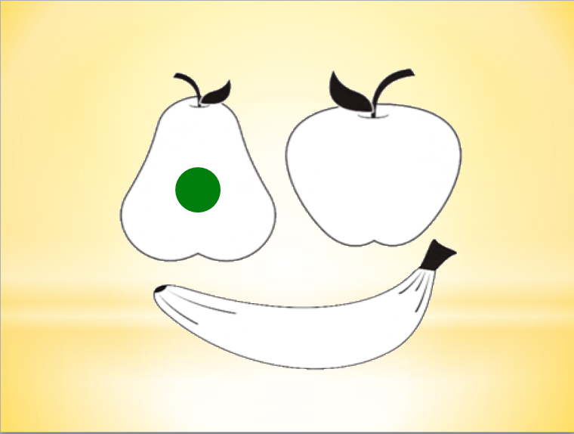

Slide 34
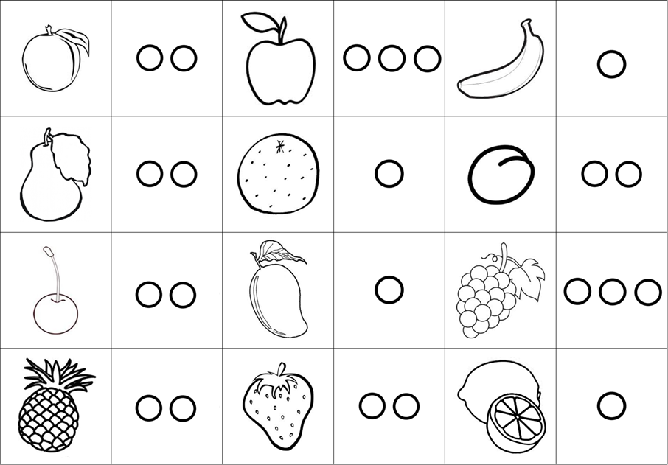

Slide 35
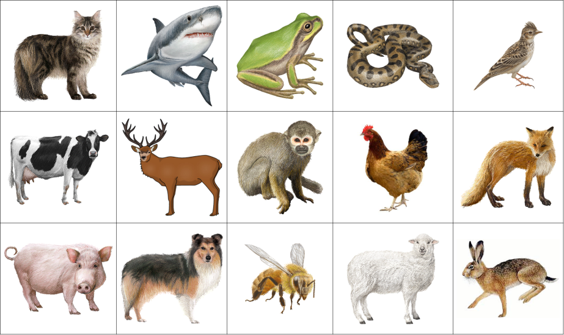

Slide 36
star rocket
sun earth
crater air
Mars moon
gravity light
telescope UFO

Slide 37
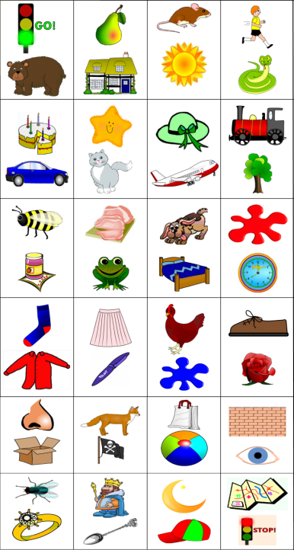

Slide 38
Would it work this way?
You can see more at my Pronunciation workshop
www.sylviad.cz – Kalendář akcí
Vsetín
Uherské Hradiště
Most
Brno
Liberec
Zlín
www.sylviad.cz

